Slide 1
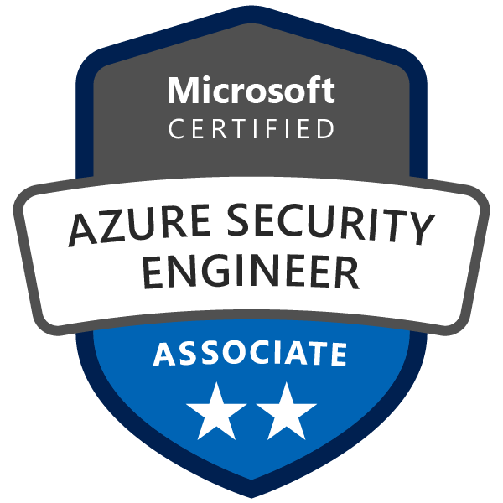
Exam AZ-500: Microsoft Azure Security Technologies Crash Course
Tim Warner

Slide 2


Tim Warner
Based in Nashville, TN, US
MCT, MVP
Twitter: @TechTrainerTim
Badge: timw.info

Slide 3
Course Materials
timw.info/az500

Slide 4
Session 1 of 2 Learning Goals
Introduction
Manage identity and access
Administer Azure AD security
Configure Azure AD PIM
Implement platform protection
Configure network, container, host security
Manage security operations
Configure Azure Security Center

Slide 5
Session 2 of 2 Learning Goals
Manage security operations, continued
Configure Azure DevOps
Configure security policies
Configure security alerts
Secure data and applications
Configure data classification
Protect data infrastructure
Configure application security and Key Vault

Slide 6
A Different Kind of Training
Let's avoid slide show fatigue
We'll learn by doing – at least 80 percent demo
Case study approach
This is an expert certification, so we will move quickly and assume intermediate-level Azure skills
5-minute break at midpoint
I’m here to answer your questions – take advantage of this!
Use the Q&A panel

Slide 7

Session Recordings

Slide 8
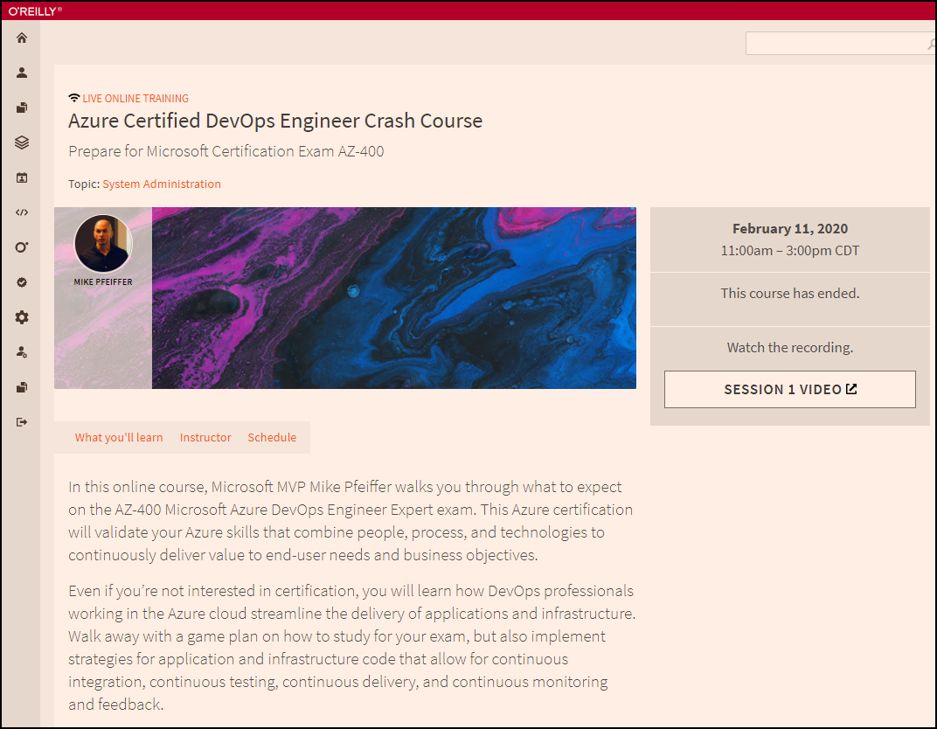
Session Recordings

Slide 9

Session Recordings

Slide 10
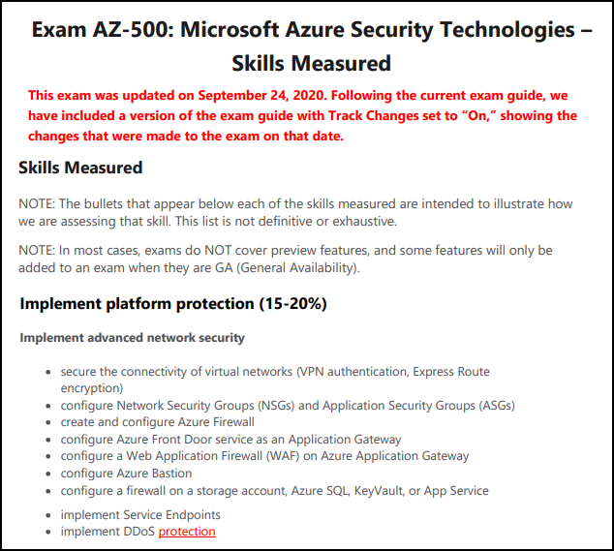
AZ-500 Changes: Nov 24, 2020

Slide 11
Tim's Certification Study Pyramid
Interdependence
Content knowledge
Practical application
Test-taking skills

Slide 12
Manage Identity and Access

Slide 13


Azure AD and Subscriptions

Slide 14
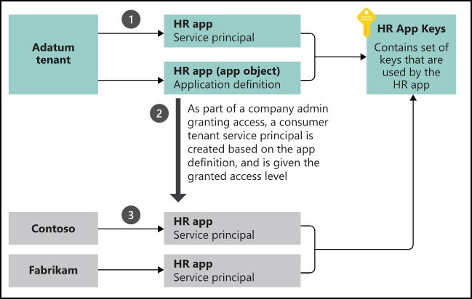
App registrations and service principals

Slide 15

Azure AD B2C

Slide 16

Azure AD Domain Services

Slide 17

Azure AD SSO

Slide 18

Passthrough Authentication

Slide 19

Seamless Single Sign-On

Slide 20

AD FS Federation

Slide 21
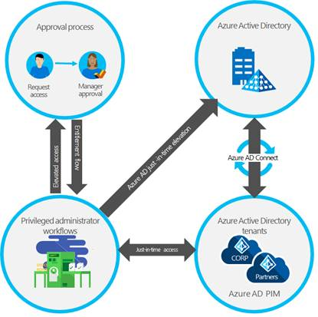
Azure AD PIM

Slide 22
Implement Platform Protection

Slide 23
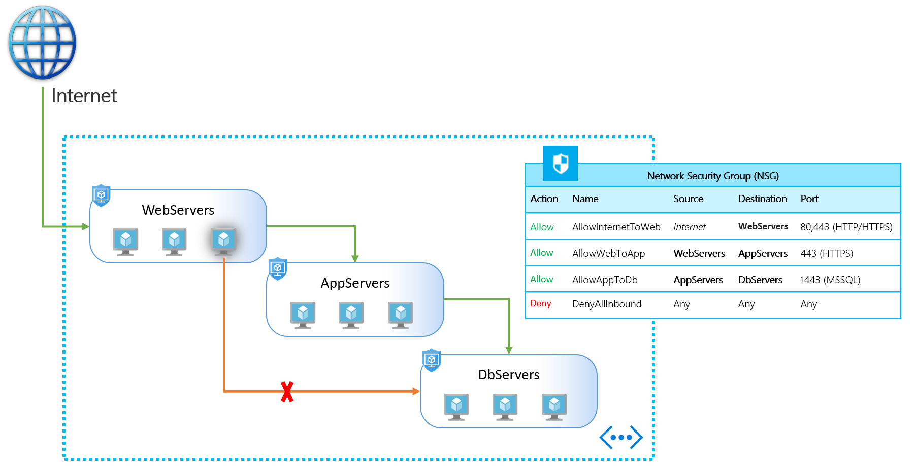
NSGs and ASGs

Slide 24

VM High Availability

Slide 25

Web App High Availability

Slide 26
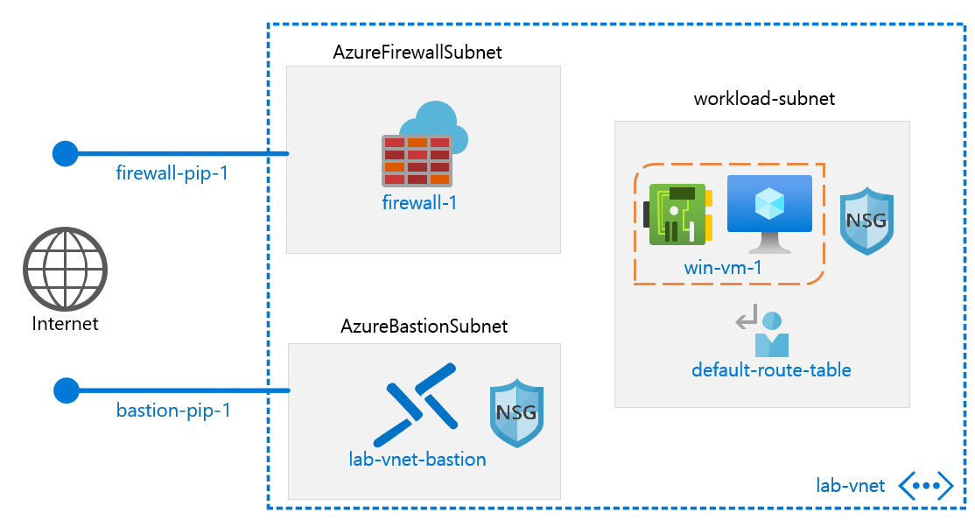
Azure Firewall

Slide 27
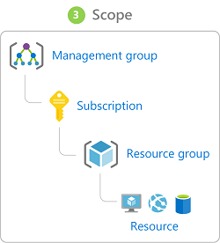
Azure Management Scopes
/ Tenant Root

Slide 28

Service endpoints

Slide 29
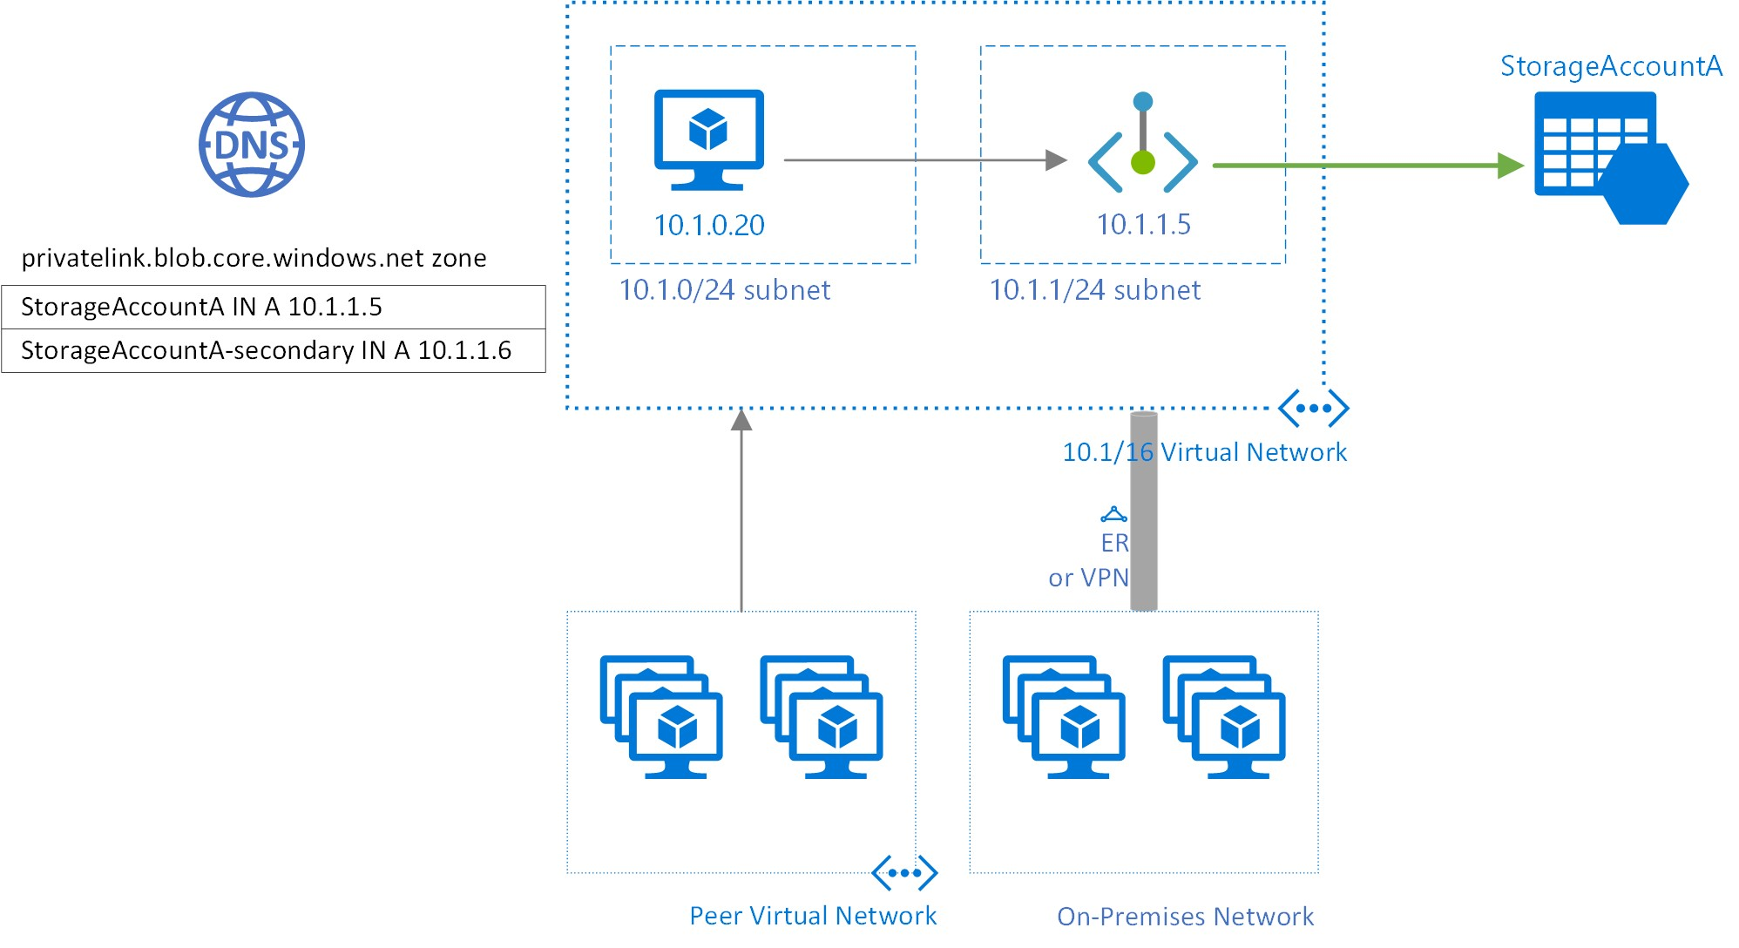
Private endpoints

Slide 30
Manage Security Operations

Slide 31
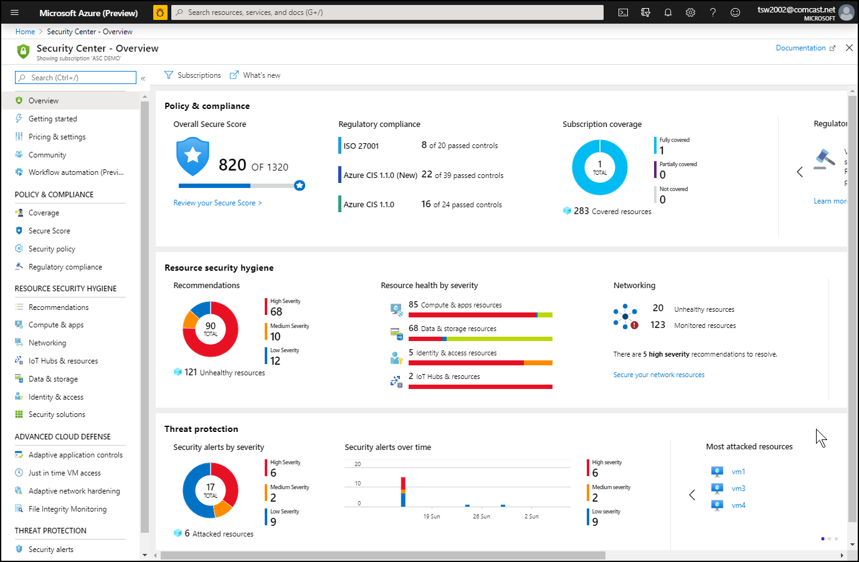
Azure Security Center

Slide 32
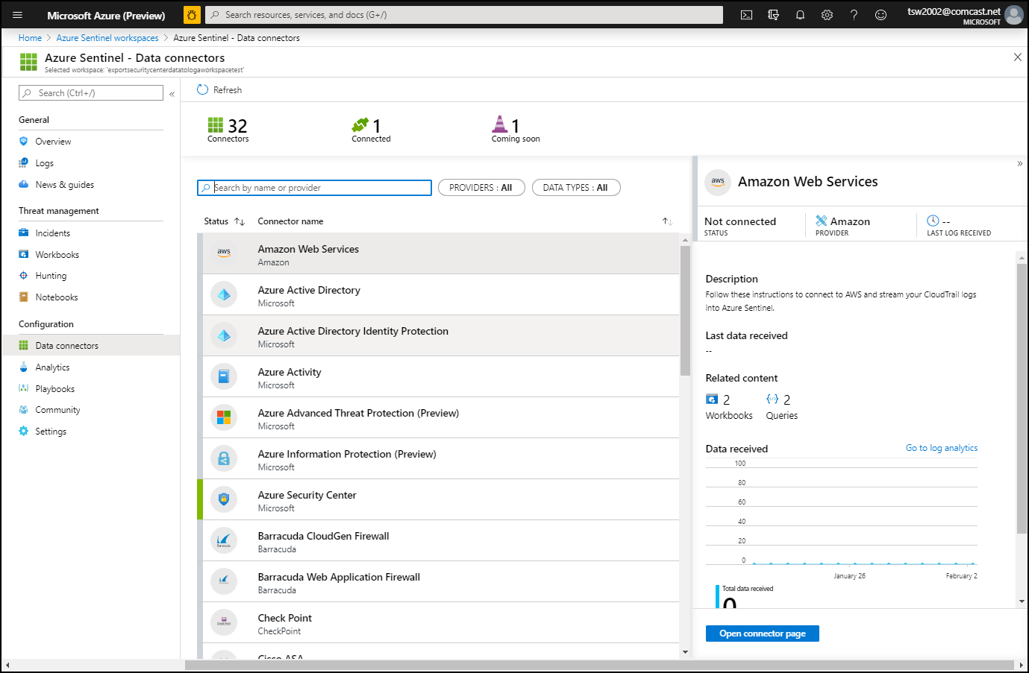
Azure Sentinel

Slide 33
Secure Data and Applications

Slide 34
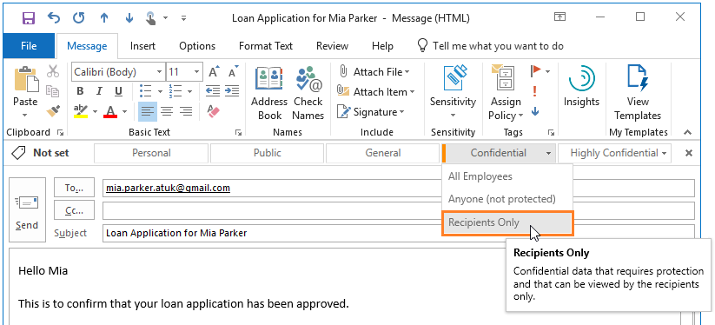
Azure Information Protection

Slide 35
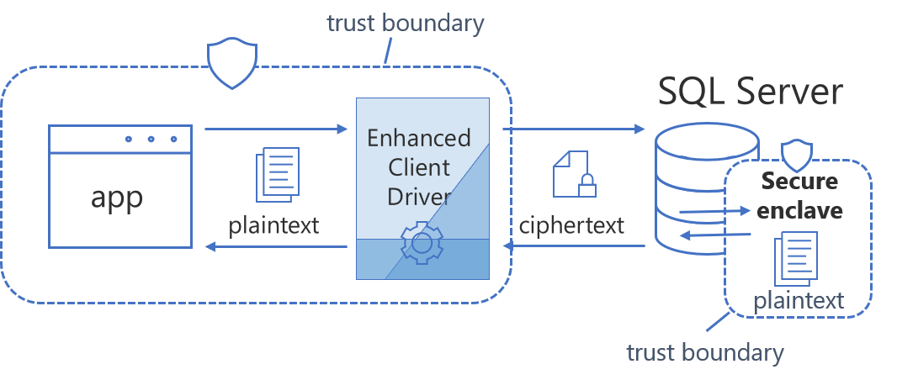
Always Encrypted

Slide 36
Exam AZ-500 Item Types

Slide 37

Single Answer Multiple Choice

Slide 38

Multiple Answer Multiple Choice

Slide 39
Repeated Scenario
You need to move an Azure VM to another hardware host.
Solution: You redeploy the VM.
Does this solution meet the goal?
Yes
No

Slide 40
Repeated Scenario
You need to move an Azure VM to another hardware host.
Solution: You enable boot diagnostics.
Does this solution meet the goal?
Yes
No

Slide 41

Select and Place

Slide 42

Build List and Reorder

Slide 43

Active Screen/Fill in the Blank

Slide 44

Case Study

Slide 45






Performance-Based Lab

Slide 46
Microsoft Online Testing

Slide 47
Microsoft Online Testing Process
timw.info/online

Slide 48

Microsoft Online Testing Process

Slide 49

Microsoft Online Testing Process

Slide 50

Microsoft Online Testing Process

Slide 51

Microsoft Online Testing Process

Slide 52

Microsoft Online Testing Process

Slide 53

Microsoft Online Testing Process

Slide 54

Microsoft Online Testing Process

Slide 55
AZ-500 Exam Strategy
Focus your skills accordingly:
60 percent Azure portal
20 percent Azure PowerShell
10 percent Azure CLI
10 percent KQL
Azure AD PIM all day long
Expect performance-based labs, but be happy if you don't see 'em

Slide 56
Parting Advice
Check out my YouTube (timw.info)
Online testing
Cert item strategy
AZ-500 study guide
Invest in Whizlabs or MeasureUp
Register for your exam ASAP!

Slide 57
Thank you!
Course materials: timw.info/az500
Twitter: @TechTrainerTim
Work: timw.info/ps
Web: timw.info

